Slide 1

Computational Physics (PHYS6350)
Lecture 16: Partial Differential Equations Part II
Initial value problems
Heat equation
Wave equation
Reference: Chapter 9 of Computational Physics by Mark Newman
March 23, 2023
Instructor: Volodymyr Vovchenko (vvovchenko@uh.edu)
Course materials: https://github.com/vlvovch/PHYS6350-ComputationalPhysics

Slide 2
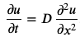
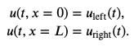
Initial value problem in PDEs
Many PDEs describe time evolution of fields u(t,x)
For example heat equation describing temperature profile
This equation describes the time evolution of u(t,x) given initial profile
and boundary conditions
If boundary conditions are static, the solution will approach a stationary profile at large times
Notes:
The important thing here, however, is that this equation defines how the mean B1 depends on t.
We can thus use this straightforwardly to calculate the higher-order cumulants by taking the derivatives from this equation with respect to t.
And by repeatedly abusing the Faa di Bruno formula for high-order derivatives of composite functions we can calculate the net-baryon cumulants subject to global baryon conservation up to a desired order.
Here I am showing the results for three cumulants ratios, the so-called scaled variance, skewness, and kurtosis, our paper contains explicit results up to order 6.
We obtain the B1 cumulants in terms of the subvolume fraction \alpha and the grand-canonical susceptibilities \chi_B.
This is exactly what we want, as the grand-canonical susceptibilities are the intrinsic properties of the equation of state that we want to probe.
Unsurprisingly, in the limit \alpha goes to zero we obtain the grand-canonical susceptibility ratios.
Let me reiterate again that here I did not assume anything about the equation of state, this result is model-independent.

Slide 3
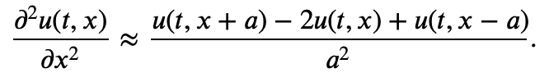
Finite difference approach to heat equation
First, one discretizes the spatial coordinate into a grid with N+1 points, i.e.
The spatial 2nd derivative is approximate with central difference
How to discretize time derivative?
Three common options:
FTCS scheme
Implicit scheme
Crank-Nicolson method
Notes:
The important thing here, however, is that this equation defines how the mean B1 depends on t.
We can thus use this straightforwardly to calculate the higher-order cumulants by taking the derivatives from this equation with respect to t.
And by repeatedly abusing the Faa di Bruno formula for high-order derivatives of composite functions we can calculate the net-baryon cumulants subject to global baryon conservation up to a desired order.
Here I am showing the results for three cumulants ratios, the so-called scaled variance, skewness, and kurtosis, our paper contains explicit results up to order 6.
We obtain the B1 cumulants in terms of the subvolume fraction \alpha and the grand-canonical susceptibilities \chi_B.
This is exactly what we want, as the grand-canonical susceptibilities are the intrinsic properties of the equation of state that we want to probe.
Unsurprisingly, in the limit \alpha goes to zero we obtain the grand-canonical susceptibility ratios.
Let me reiterate again that here I did not assume anything about the equation of state, this result is model-independent.

Slide 4
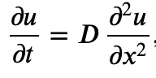
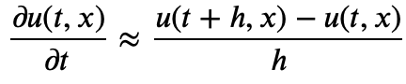
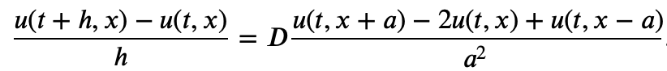
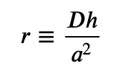
Finite difference approach to heat equation: FTCS scheme
FTCS (Finite Time Centered Space) scheme
Time derivative approximated by forward difference
This gives the following discretized PDE
The method is explicit: to evaluate u(t+h,x) only need u(t,x)
Discretized form
Notes:
The important thing here, however, is that this equation defines how the mean B1 depends on t.
We can thus use this straightforwardly to calculate the higher-order cumulants by taking the derivatives from this equation with respect to t.
And by repeatedly abusing the Faa di Bruno formula for high-order derivatives of composite functions we can calculate the net-baryon cumulants subject to global baryon conservation up to a desired order.
Here I am showing the results for three cumulants ratios, the so-called scaled variance, skewness, and kurtosis, our paper contains explicit results up to order 6.
We obtain the B1 cumulants in terms of the subvolume fraction \alpha and the grand-canonical susceptibilities \chi_B.
This is exactly what we want, as the grand-canonical susceptibilities are the intrinsic properties of the equation of state that we want to probe.
Unsurprisingly, in the limit \alpha goes to zero we obtain the grand-canonical susceptibility ratios.
Let me reiterate again that here I did not assume anything about the equation of state, this result is model-independent.

Slide 5
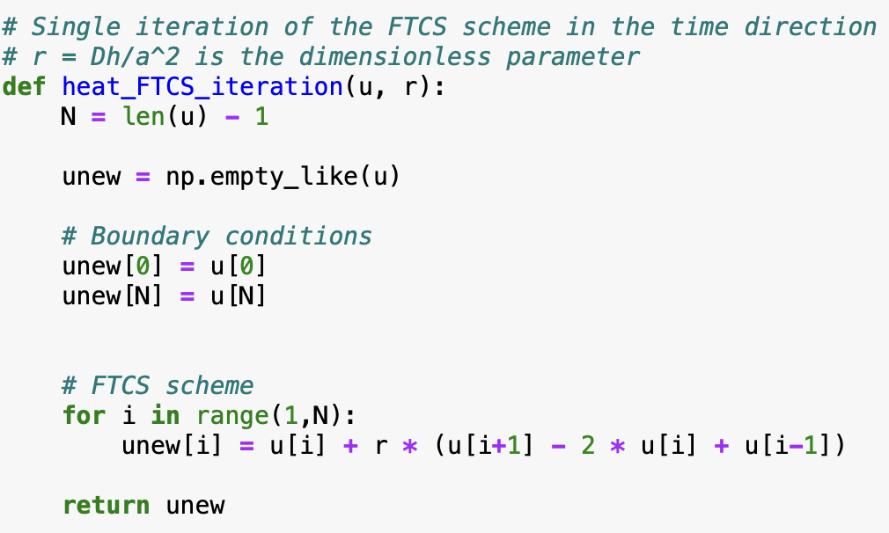
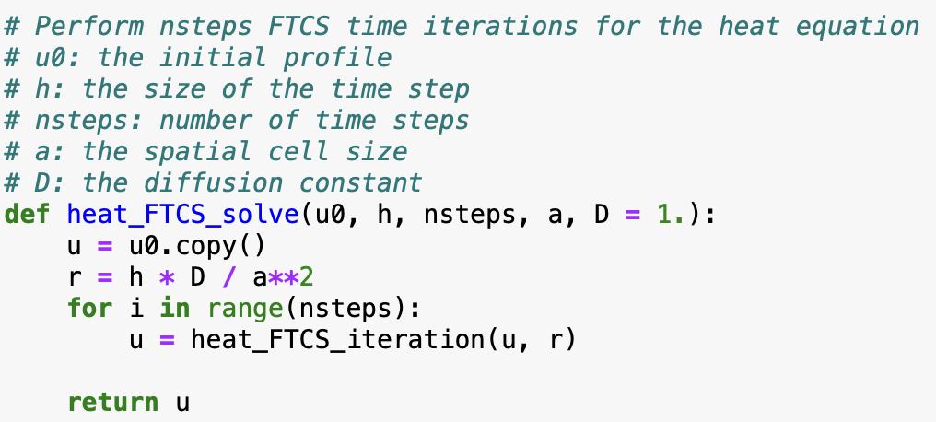
FTCS scheme for heat equation
Notes:
The important thing here, however, is that this equation defines how the mean B1 depends on t.
We can thus use this straightforwardly to calculate the higher-order cumulants by taking the derivatives from this equation with respect to t.
And by repeatedly abusing the Faa di Bruno formula for high-order derivatives of composite functions we can calculate the net-baryon cumulants subject to global baryon conservation up to a desired order.
Here I am showing the results for three cumulants ratios, the so-called scaled variance, skewness, and kurtosis, our paper contains explicit results up to order 6.
We obtain the B1 cumulants in terms of the subvolume fraction \alpha and the grand-canonical susceptibilities \chi_B.
This is exactly what we want, as the grand-canonical susceptibilities are the intrinsic properties of the equation of state that we want to probe.
Unsurprisingly, in the limit \alpha goes to zero we obtain the grand-canonical susceptibility ratios.
Let me reiterate again that here I did not assume anything about the equation of state, this result is model-independent.

Slide 6
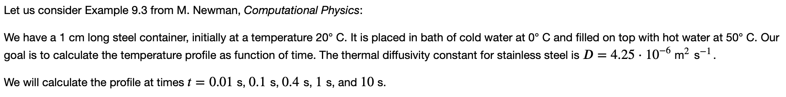
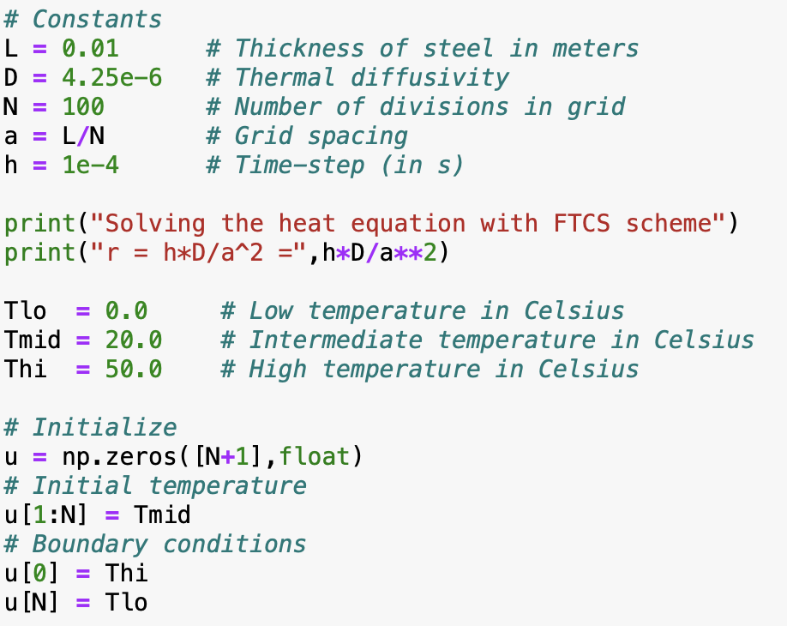
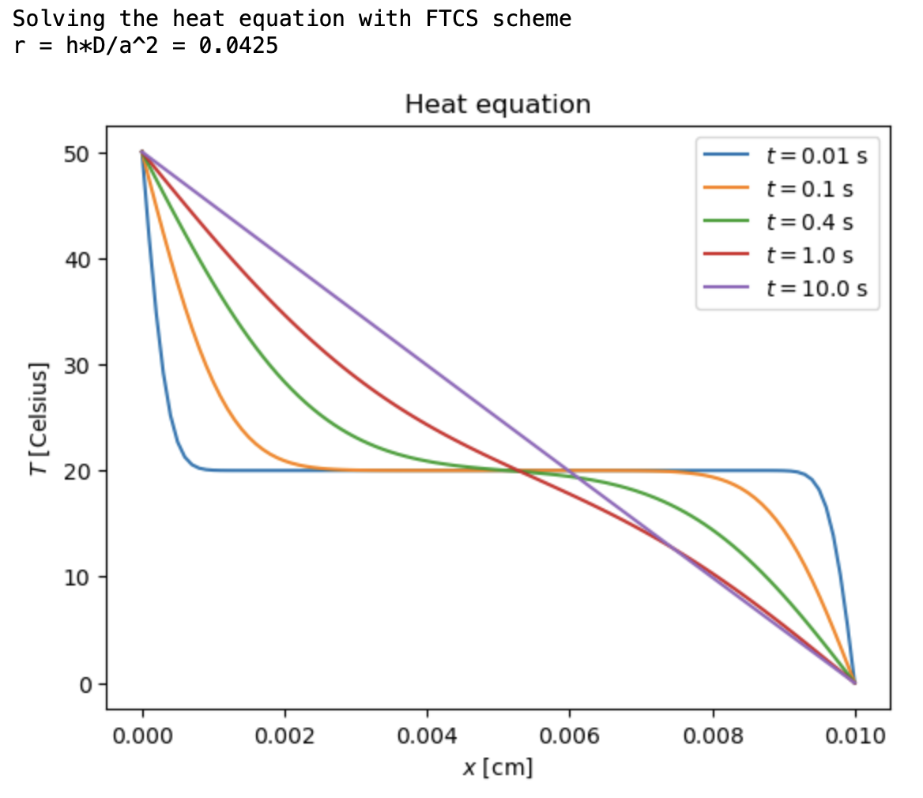
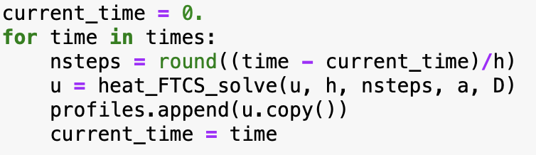
Example
Notes:
The important thing here, however, is that this equation defines how the mean B1 depends on t.
We can thus use this straightforwardly to calculate the higher-order cumulants by taking the derivatives from this equation with respect to t.
And by repeatedly abusing the Faa di Bruno formula for high-order derivatives of composite functions we can calculate the net-baryon cumulants subject to global baryon conservation up to a desired order.
Here I am showing the results for three cumulants ratios, the so-called scaled variance, skewness, and kurtosis, our paper contains explicit results up to order 6.
We obtain the B1 cumulants in terms of the subvolume fraction \alpha and the grand-canonical susceptibilities \chi_B.
This is exactly what we want, as the grand-canonical susceptibilities are the intrinsic properties of the equation of state that we want to probe.
Unsurprisingly, in the limit \alpha goes to zero we obtain the grand-canonical susceptibility ratios.
Let me reiterate again that here I did not assume anything about the equation of state, this result is model-independent.

Slide 7
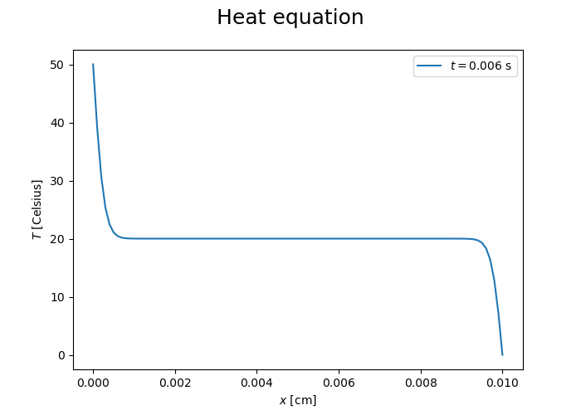
Animation
Notes:
The important thing here, however, is that this equation defines how the mean B1 depends on t.
We can thus use this straightforwardly to calculate the higher-order cumulants by taking the derivatives from this equation with respect to t.
And by repeatedly abusing the Faa di Bruno formula for high-order derivatives of composite functions we can calculate the net-baryon cumulants subject to global baryon conservation up to a desired order.
Here I am showing the results for three cumulants ratios, the so-called scaled variance, skewness, and kurtosis, our paper contains explicit results up to order 6.
We obtain the B1 cumulants in terms of the subvolume fraction \alpha and the grand-canonical susceptibilities \chi_B.
This is exactly what we want, as the grand-canonical susceptibilities are the intrinsic properties of the equation of state that we want to probe.
Unsurprisingly, in the limit \alpha goes to zero we obtain the grand-canonical susceptibility ratios.
Let me reiterate again that here I did not assume anything about the equation of state, this result is model-independent.

Slide 8
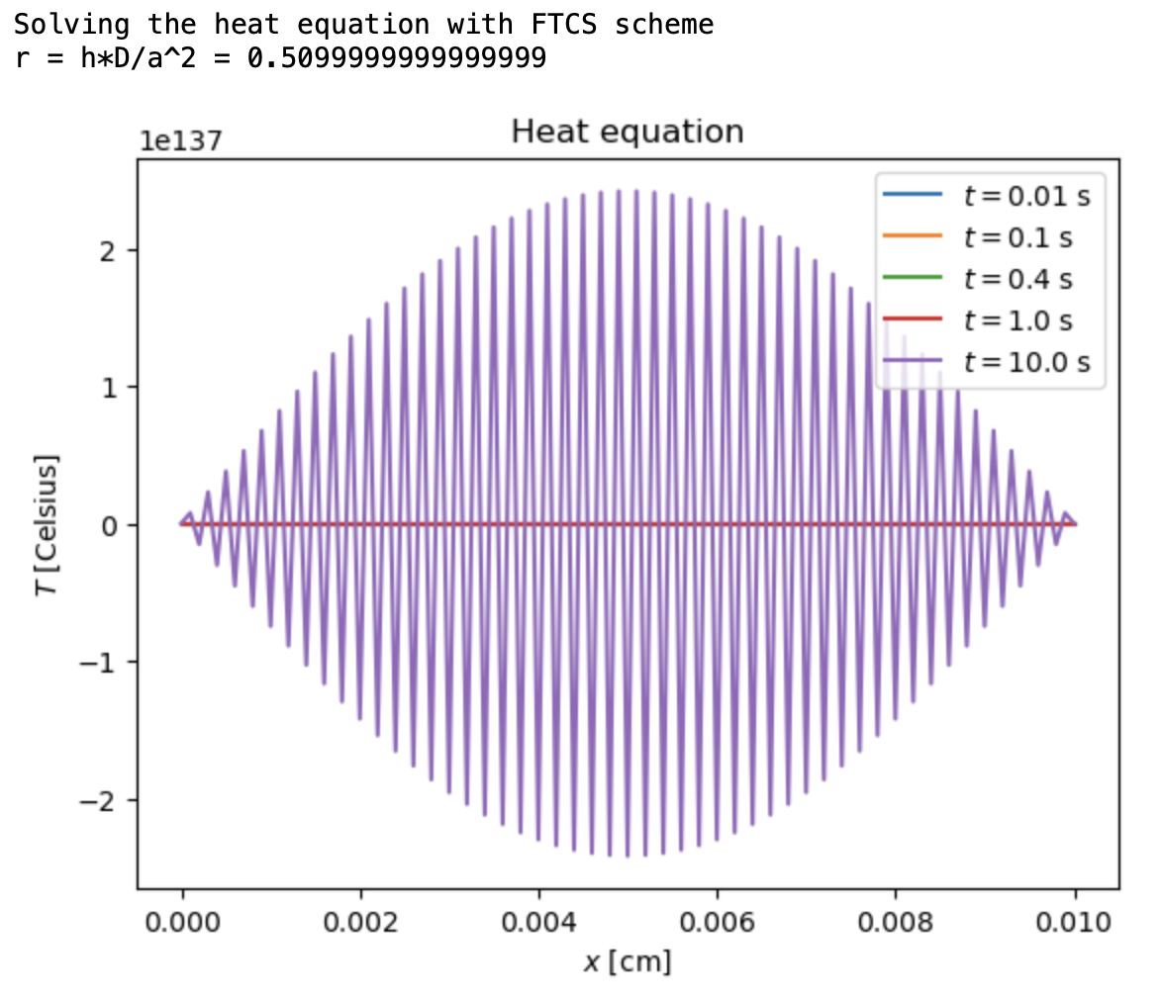
Try a larger time step
The method is unstable if r > 0.5
Notes:
The important thing here, however, is that this equation defines how the mean B1 depends on t.
We can thus use this straightforwardly to calculate the higher-order cumulants by taking the derivatives from this equation with respect to t.
And by repeatedly abusing the Faa di Bruno formula for high-order derivatives of composite functions we can calculate the net-baryon cumulants subject to global baryon conservation up to a desired order.
Here I am showing the results for three cumulants ratios, the so-called scaled variance, skewness, and kurtosis, our paper contains explicit results up to order 6.
We obtain the B1 cumulants in terms of the subvolume fraction \alpha and the grand-canonical susceptibilities \chi_B.
This is exactly what we want, as the grand-canonical susceptibilities are the intrinsic properties of the equation of state that we want to probe.
Unsurprisingly, in the limit \alpha goes to zero we obtain the grand-canonical susceptibility ratios.
Let me reiterate again that here I did not assume anything about the equation of state, this result is model-independent.

Slide 9
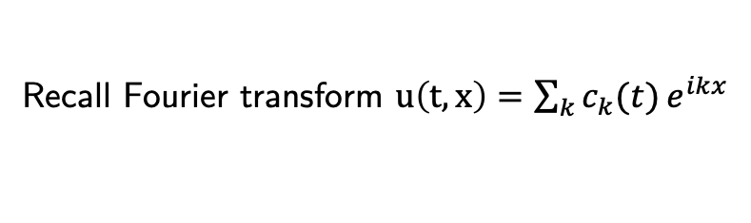
Stability analysis: Neumann method
Recall Fourier transform $u\left(t,x\right)=\sum_{k}{c_{k}(t)}e^{ikx}$
Analyze the following solutions: $u\left(t,x\right)=c_{k}(t)e^{ikx}$
Plugging into
one gets
i.e.
The method is stable if r<1/2
Notes:
The important thing here, however, is that this equation defines how the mean B1 depends on t.
We can thus use this straightforwardly to calculate the higher-order cumulants by taking the derivatives from this equation with respect to t.
And by repeatedly abusing the Faa di Bruno formula for high-order derivatives of composite functions we can calculate the net-baryon cumulants subject to global baryon conservation up to a desired order.
Here I am showing the results for three cumulants ratios, the so-called scaled variance, skewness, and kurtosis, our paper contains explicit results up to order 6.
We obtain the B1 cumulants in terms of the subvolume fraction \alpha and the grand-canonical susceptibilities \chi_B.
This is exactly what we want, as the grand-canonical susceptibilities are the intrinsic properties of the equation of state that we want to probe.
Unsurprisingly, in the limit \alpha goes to zero we obtain the grand-canonical susceptibility ratios.
Let me reiterate again that here I did not assume anything about the equation of state, this result is model-independent.

Slide 10
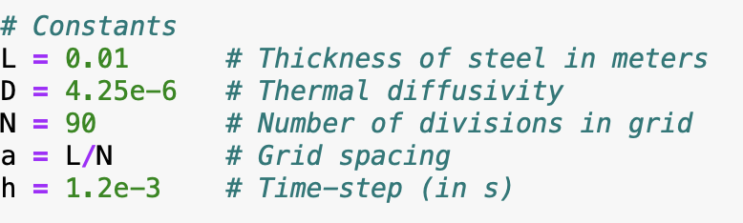
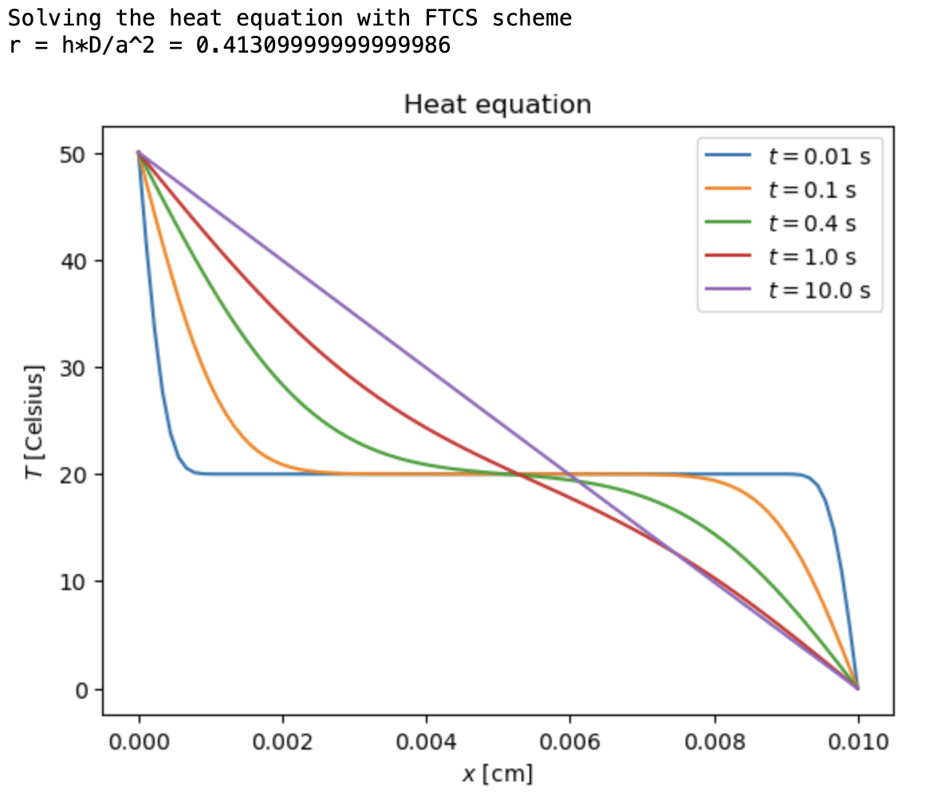
Try a larger space step to compensate for large time step
Notes:
The important thing here, however, is that this equation defines how the mean B1 depends on t.
We can thus use this straightforwardly to calculate the higher-order cumulants by taking the derivatives from this equation with respect to t.
And by repeatedly abusing the Faa di Bruno formula for high-order derivatives of composite functions we can calculate the net-baryon cumulants subject to global baryon conservation up to a desired order.
Here I am showing the results for three cumulants ratios, the so-called scaled variance, skewness, and kurtosis, our paper contains explicit results up to order 6.
We obtain the B1 cumulants in terms of the subvolume fraction \alpha and the grand-canonical susceptibilities \chi_B.
This is exactly what we want, as the grand-canonical susceptibilities are the intrinsic properties of the equation of state that we want to probe.
Unsurprisingly, in the limit \alpha goes to zero we obtain the grand-canonical susceptibility ratios.
Let me reiterate again that here I did not assume anything about the equation of state, this result is model-independent.

Slide 11
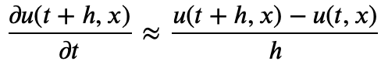
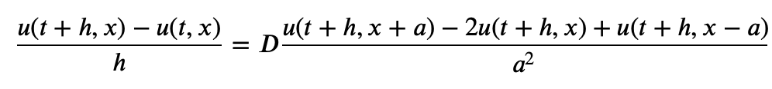
Implicit scheme
Time derivative approximated by backward difference
This gives the following discretized PDE
Discretized form
Tridiagonal system of linear equations at each step
Neumann stability analysis: method is stable for any r
Notes:
The important thing here, however, is that this equation defines how the mean B1 depends on t.
We can thus use this straightforwardly to calculate the higher-order cumulants by taking the derivatives from this equation with respect to t.
And by repeatedly abusing the Faa di Bruno formula for high-order derivatives of composite functions we can calculate the net-baryon cumulants subject to global baryon conservation up to a desired order.
Here I am showing the results for three cumulants ratios, the so-called scaled variance, skewness, and kurtosis, our paper contains explicit results up to order 6.
We obtain the B1 cumulants in terms of the subvolume fraction \alpha and the grand-canonical susceptibilities \chi_B.
This is exactly what we want, as the grand-canonical susceptibilities are the intrinsic properties of the equation of state that we want to probe.
Unsurprisingly, in the limit \alpha goes to zero we obtain the grand-canonical susceptibility ratios.
Let me reiterate again that here I did not assume anything about the equation of state, this result is model-independent.

Slide 12
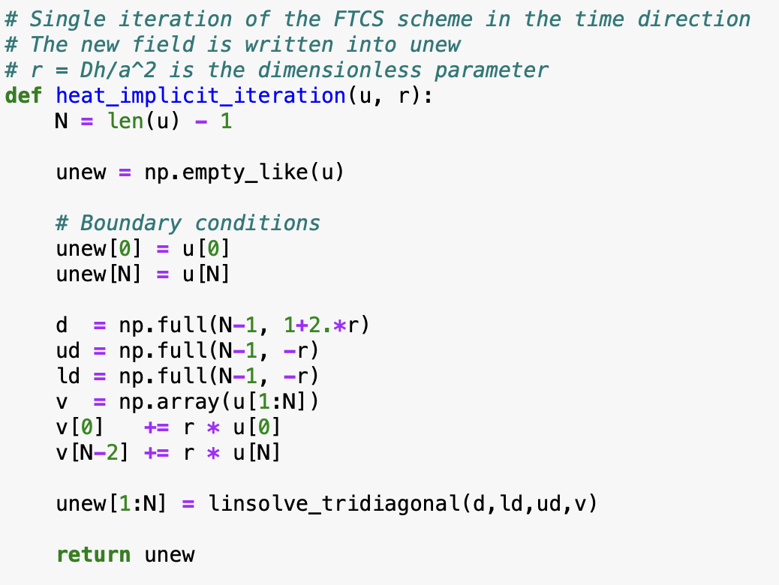
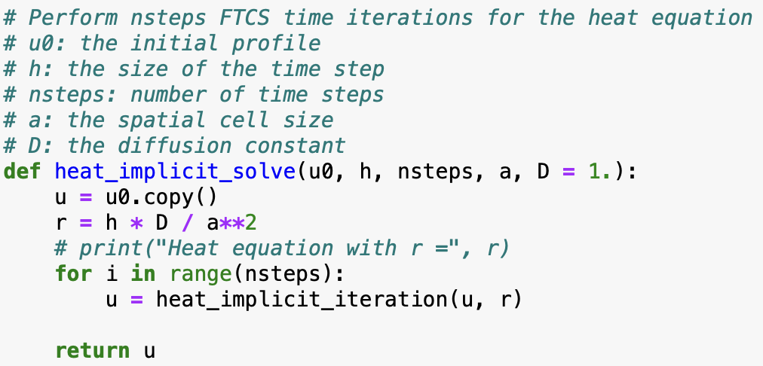
Implicit scheme for heat equation
Notes:
The important thing here, however, is that this equation defines how the mean B1 depends on t.
We can thus use this straightforwardly to calculate the higher-order cumulants by taking the derivatives from this equation with respect to t.
And by repeatedly abusing the Faa di Bruno formula for high-order derivatives of composite functions we can calculate the net-baryon cumulants subject to global baryon conservation up to a desired order.
Here I am showing the results for three cumulants ratios, the so-called scaled variance, skewness, and kurtosis, our paper contains explicit results up to order 6.
We obtain the B1 cumulants in terms of the subvolume fraction \alpha and the grand-canonical susceptibilities \chi_B.
This is exactly what we want, as the grand-canonical susceptibilities are the intrinsic properties of the equation of state that we want to probe.
Unsurprisingly, in the limit \alpha goes to zero we obtain the grand-canonical susceptibility ratios.
Let me reiterate again that here I did not assume anything about the equation of state, this result is model-independent.

Slide 13
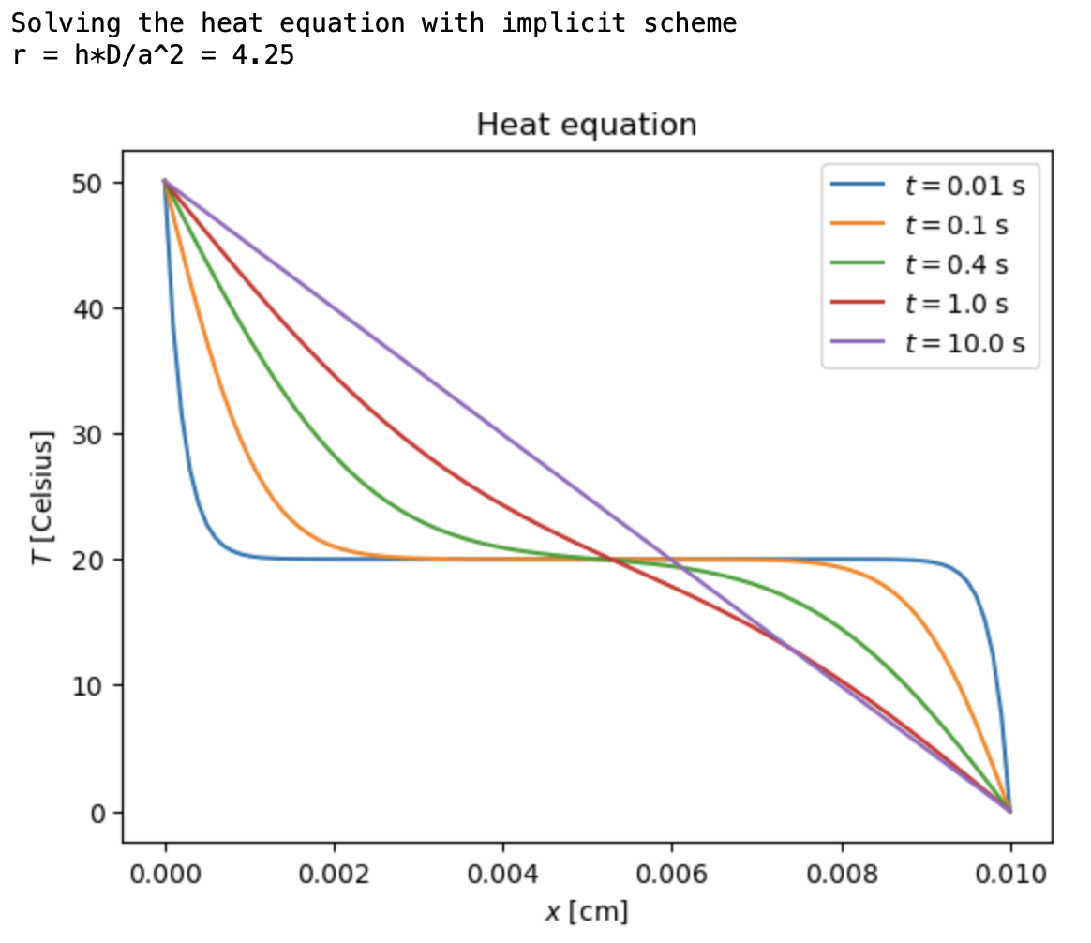
Implicit scheme: large time step
Notes:
The important thing here, however, is that this equation defines how the mean B1 depends on t.
We can thus use this straightforwardly to calculate the higher-order cumulants by taking the derivatives from this equation with respect to t.
And by repeatedly abusing the Faa di Bruno formula for high-order derivatives of composite functions we can calculate the net-baryon cumulants subject to global baryon conservation up to a desired order.
Here I am showing the results for three cumulants ratios, the so-called scaled variance, skewness, and kurtosis, our paper contains explicit results up to order 6.
We obtain the B1 cumulants in terms of the subvolume fraction \alpha and the grand-canonical susceptibilities \chi_B.
This is exactly what we want, as the grand-canonical susceptibilities are the intrinsic properties of the equation of state that we want to probe.
Unsurprisingly, in the limit \alpha goes to zero we obtain the grand-canonical susceptibility ratios.
Let me reiterate again that here I did not assume anything about the equation of state, this result is model-independent.

Slide 14
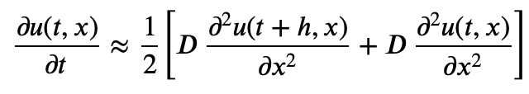
Crank-Nicolson scheme
“Average” between forward and backward difference
Essentially a trapezoidal rule for the time integration (more accurate than forward/backward differences)
Discretized form
Tridiagonal system of linear equations at each step
Neumann stability analysis: method is stable for any r
Notes:
The important thing here, however, is that this equation defines how the mean B1 depends on t.
We can thus use this straightforwardly to calculate the higher-order cumulants by taking the derivatives from this equation with respect to t.
And by repeatedly abusing the Faa di Bruno formula for high-order derivatives of composite functions we can calculate the net-baryon cumulants subject to global baryon conservation up to a desired order.
Here I am showing the results for three cumulants ratios, the so-called scaled variance, skewness, and kurtosis, our paper contains explicit results up to order 6.
We obtain the B1 cumulants in terms of the subvolume fraction \alpha and the grand-canonical susceptibilities \chi_B.
This is exactly what we want, as the grand-canonical susceptibilities are the intrinsic properties of the equation of state that we want to probe.
Unsurprisingly, in the limit \alpha goes to zero we obtain the grand-canonical susceptibility ratios.
Let me reiterate again that here I did not assume anything about the equation of state, this result is model-independent.

Slide 15
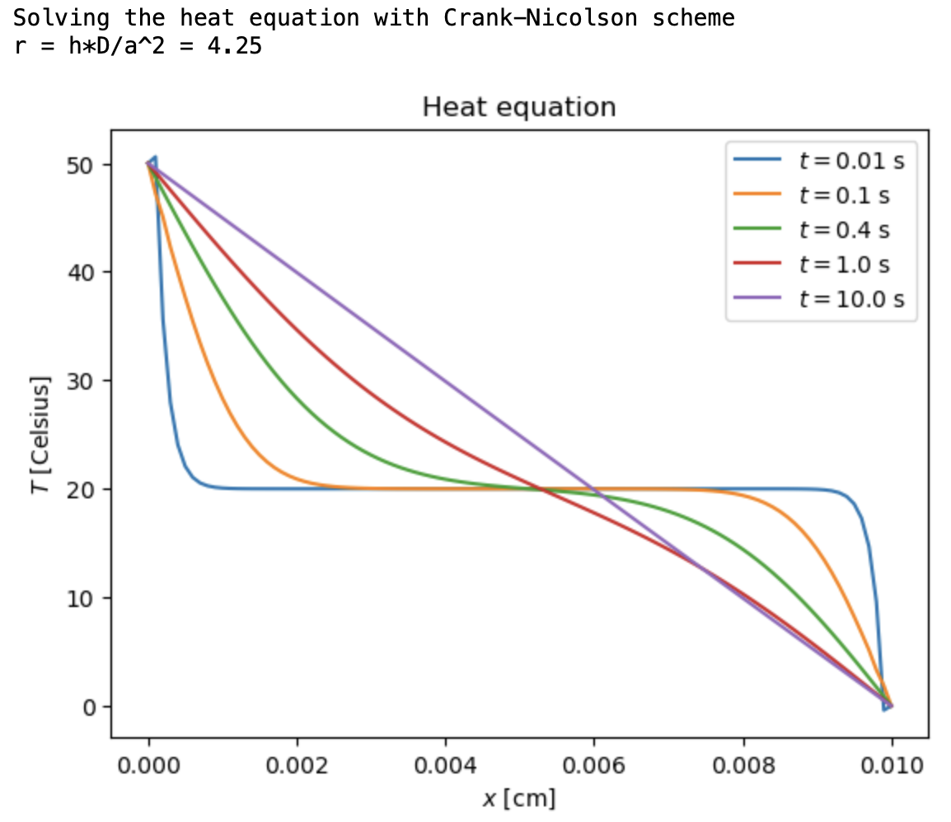
Crank-Nicolson scheme: large time step
Notes:
The important thing here, however, is that this equation defines how the mean B1 depends on t.
We can thus use this straightforwardly to calculate the higher-order cumulants by taking the derivatives from this equation with respect to t.
And by repeatedly abusing the Faa di Bruno formula for high-order derivatives of composite functions we can calculate the net-baryon cumulants subject to global baryon conservation up to a desired order.
Here I am showing the results for three cumulants ratios, the so-called scaled variance, skewness, and kurtosis, our paper contains explicit results up to order 6.
We obtain the B1 cumulants in terms of the subvolume fraction \alpha and the grand-canonical susceptibilities \chi_B.
This is exactly what we want, as the grand-canonical susceptibilities are the intrinsic properties of the equation of state that we want to probe.
Unsurprisingly, in the limit \alpha goes to zero we obtain the grand-canonical susceptibility ratios.
Let me reiterate again that here I did not assume anything about the equation of state, this result is model-independent.

Slide 16
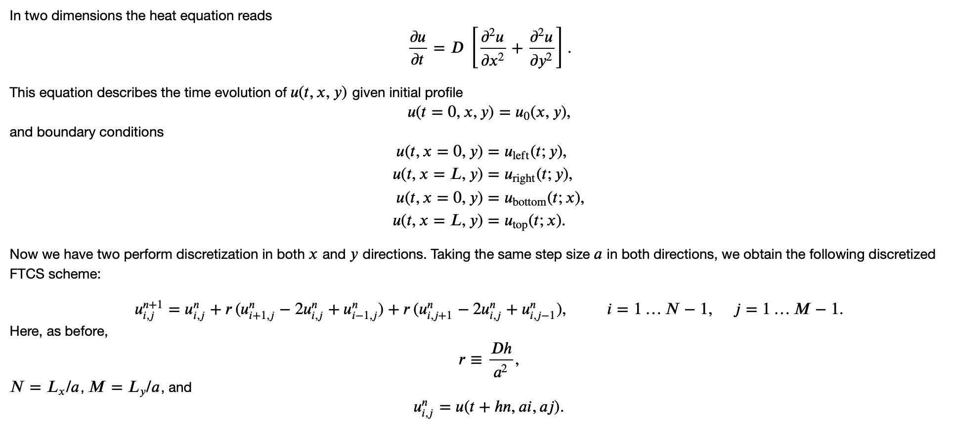
Heat equation in two dimensions
Notes:
The important thing here, however, is that this equation defines how the mean B1 depends on t.
We can thus use this straightforwardly to calculate the higher-order cumulants by taking the derivatives from this equation with respect to t.
And by repeatedly abusing the Faa di Bruno formula for high-order derivatives of composite functions we can calculate the net-baryon cumulants subject to global baryon conservation up to a desired order.
Here I am showing the results for three cumulants ratios, the so-called scaled variance, skewness, and kurtosis, our paper contains explicit results up to order 6.
We obtain the B1 cumulants in terms of the subvolume fraction \alpha and the grand-canonical susceptibilities \chi_B.
This is exactly what we want, as the grand-canonical susceptibilities are the intrinsic properties of the equation of state that we want to probe.
Unsurprisingly, in the limit \alpha goes to zero we obtain the grand-canonical susceptibility ratios.
Let me reiterate again that here I did not assume anything about the equation of state, this result is model-independent.

Slide 17
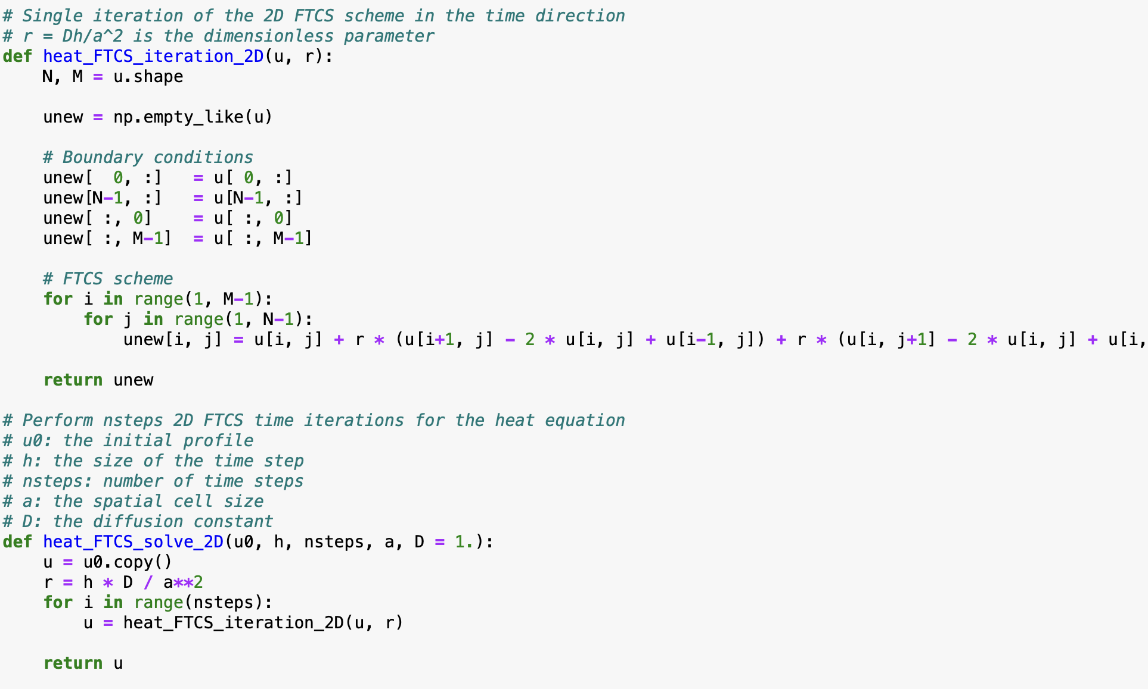
Heat equation in two dimensions: FTCS scheme
Notes:
The important thing here, however, is that this equation defines how the mean B1 depends on t.
We can thus use this straightforwardly to calculate the higher-order cumulants by taking the derivatives from this equation with respect to t.
And by repeatedly abusing the Faa di Bruno formula for high-order derivatives of composite functions we can calculate the net-baryon cumulants subject to global baryon conservation up to a desired order.
Here I am showing the results for three cumulants ratios, the so-called scaled variance, skewness, and kurtosis, our paper contains explicit results up to order 6.
We obtain the B1 cumulants in terms of the subvolume fraction \alpha and the grand-canonical susceptibilities \chi_B.
This is exactly what we want, as the grand-canonical susceptibilities are the intrinsic properties of the equation of state that we want to probe.
Unsurprisingly, in the limit \alpha goes to zero we obtain the grand-canonical susceptibility ratios.
Let me reiterate again that here I did not assume anything about the equation of state, this result is model-independent.

Slide 18
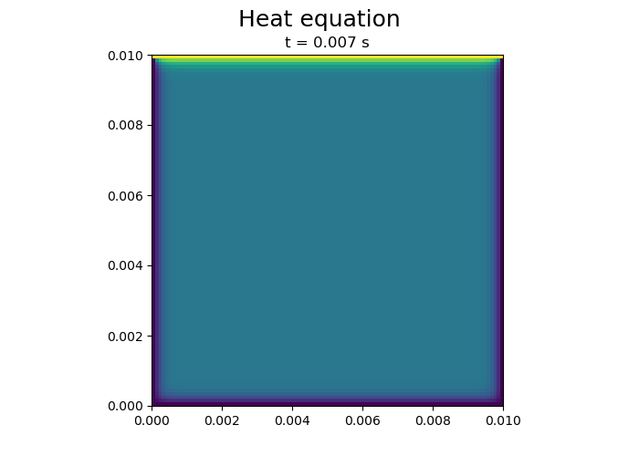
Heat equation in two dimensions: FTCS scheme
Notes:
The important thing here, however, is that this equation defines how the mean B1 depends on t.
We can thus use this straightforwardly to calculate the higher-order cumulants by taking the derivatives from this equation with respect to t.
And by repeatedly abusing the Faa di Bruno formula for high-order derivatives of composite functions we can calculate the net-baryon cumulants subject to global baryon conservation up to a desired order.
Here I am showing the results for three cumulants ratios, the so-called scaled variance, skewness, and kurtosis, our paper contains explicit results up to order 6.
We obtain the B1 cumulants in terms of the subvolume fraction \alpha and the grand-canonical susceptibilities \chi_B.
This is exactly what we want, as the grand-canonical susceptibilities are the intrinsic properties of the equation of state that we want to probe.
Unsurprisingly, in the limit \alpha goes to zero we obtain the grand-canonical susceptibility ratios.
Let me reiterate again that here I did not assume anything about the equation of state, this result is model-independent.

Slide 19
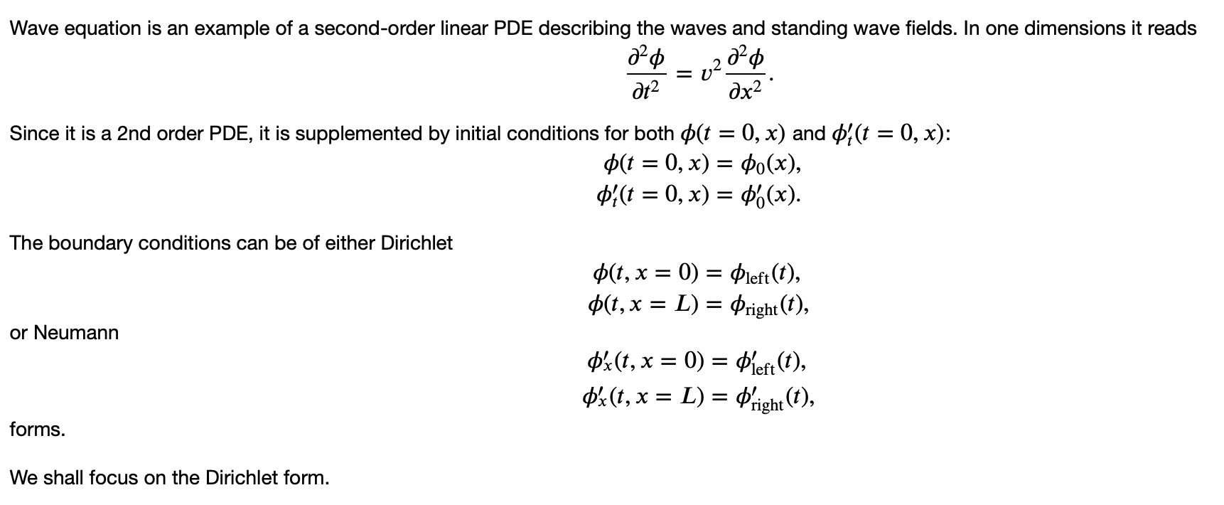
Wave equation
Notes:
The important thing here, however, is that this equation defines how the mean B1 depends on t.
We can thus use this straightforwardly to calculate the higher-order cumulants by taking the derivatives from this equation with respect to t.
And by repeatedly abusing the Faa di Bruno formula for high-order derivatives of composite functions we can calculate the net-baryon cumulants subject to global baryon conservation up to a desired order.
Here I am showing the results for three cumulants ratios, the so-called scaled variance, skewness, and kurtosis, our paper contains explicit results up to order 6.
We obtain the B1 cumulants in terms of the subvolume fraction \alpha and the grand-canonical susceptibilities \chi_B.
This is exactly what we want, as the grand-canonical susceptibilities are the intrinsic properties of the equation of state that we want to probe.
Unsurprisingly, in the limit \alpha goes to zero we obtain the grand-canonical susceptibility ratios.
Let me reiterate again that here I did not assume anything about the equation of state, this result is model-independent.

Slide 20
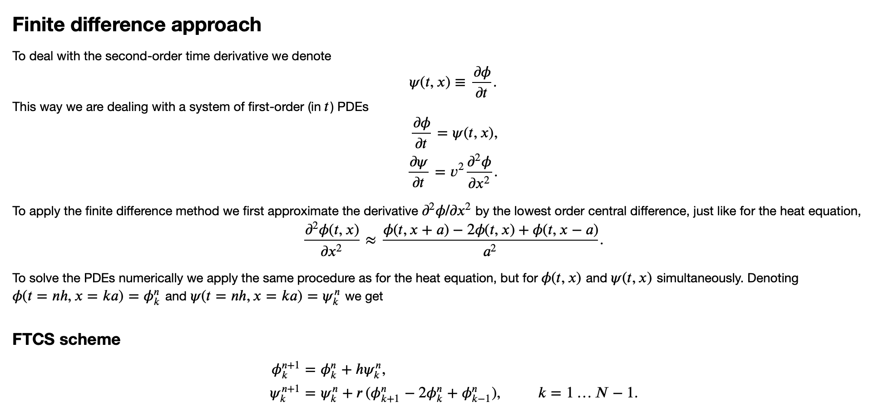
Finite difference approach
Notes:
The important thing here, however, is that this equation defines how the mean B1 depends on t.
We can thus use this straightforwardly to calculate the higher-order cumulants by taking the derivatives from this equation with respect to t.
And by repeatedly abusing the Faa di Bruno formula for high-order derivatives of composite functions we can calculate the net-baryon cumulants subject to global baryon conservation up to a desired order.
Here I am showing the results for three cumulants ratios, the so-called scaled variance, skewness, and kurtosis, our paper contains explicit results up to order 6.
We obtain the B1 cumulants in terms of the subvolume fraction \alpha and the grand-canonical susceptibilities \chi_B.
This is exactly what we want, as the grand-canonical susceptibilities are the intrinsic properties of the equation of state that we want to probe.
Unsurprisingly, in the limit \alpha goes to zero we obtain the grand-canonical susceptibility ratios.
Let me reiterate again that here I did not assume anything about the equation of state, this result is model-independent.

Slide 21
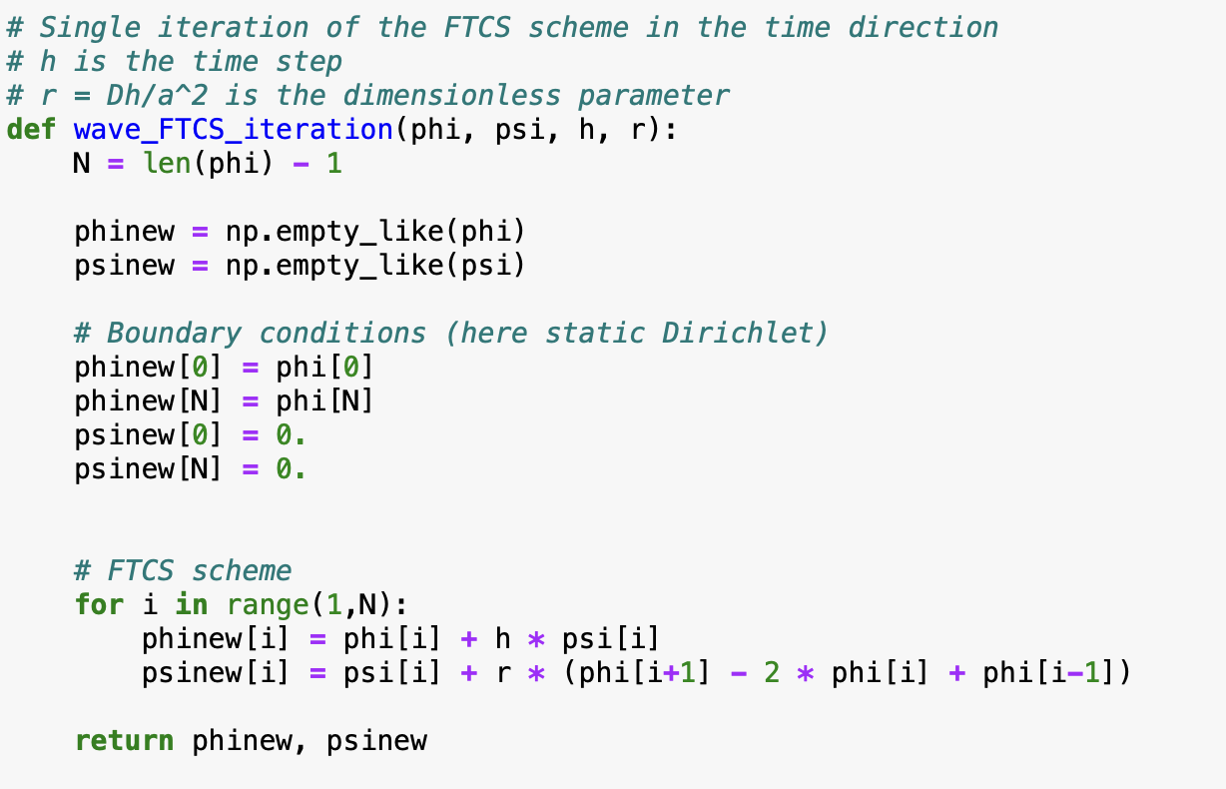
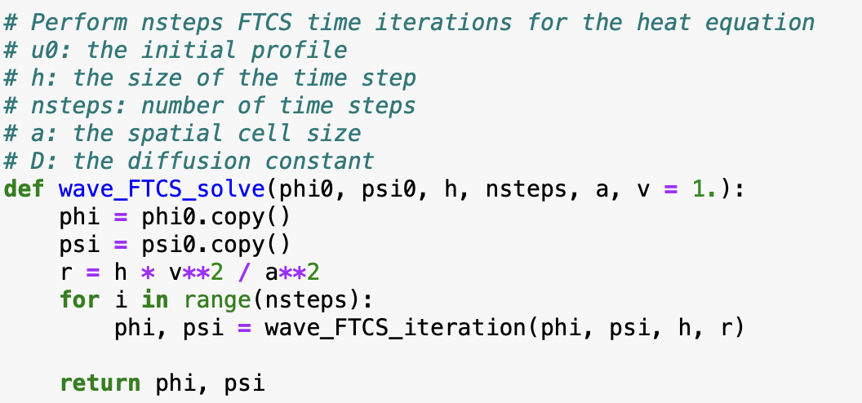
Wave equation
Notes:
The important thing here, however, is that this equation defines how the mean B1 depends on t.
We can thus use this straightforwardly to calculate the higher-order cumulants by taking the derivatives from this equation with respect to t.
And by repeatedly abusing the Faa di Bruno formula for high-order derivatives of composite functions we can calculate the net-baryon cumulants subject to global baryon conservation up to a desired order.
Here I am showing the results for three cumulants ratios, the so-called scaled variance, skewness, and kurtosis, our paper contains explicit results up to order 6.
We obtain the B1 cumulants in terms of the subvolume fraction \alpha and the grand-canonical susceptibilities \chi_B.
This is exactly what we want, as the grand-canonical susceptibilities are the intrinsic properties of the equation of state that we want to probe.
Unsurprisingly, in the limit \alpha goes to zero we obtain the grand-canonical susceptibility ratios.
Let me reiterate again that here I did not assume anything about the equation of state, this result is model-independent.

Slide 22
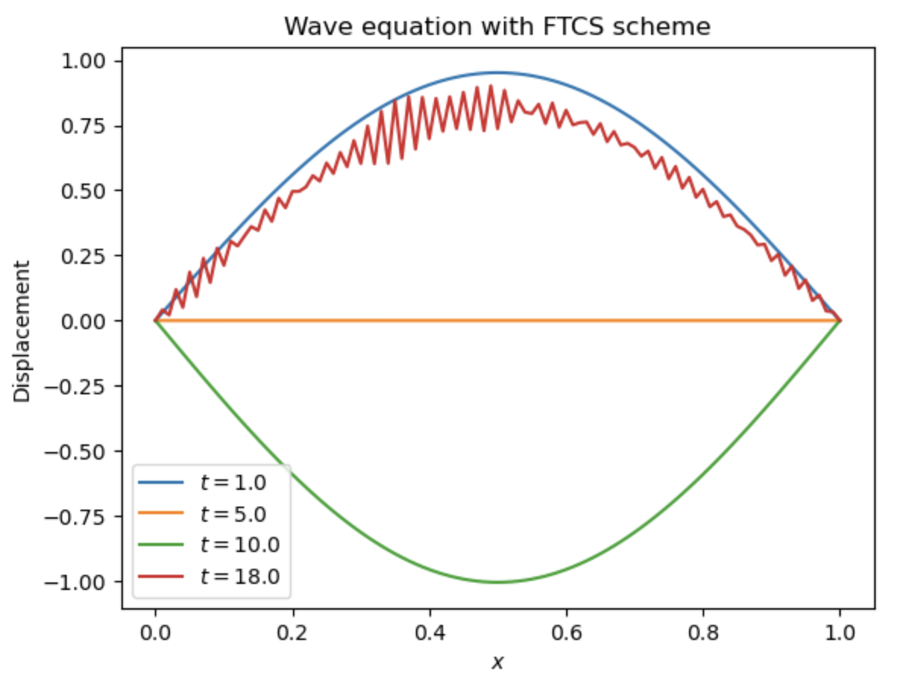
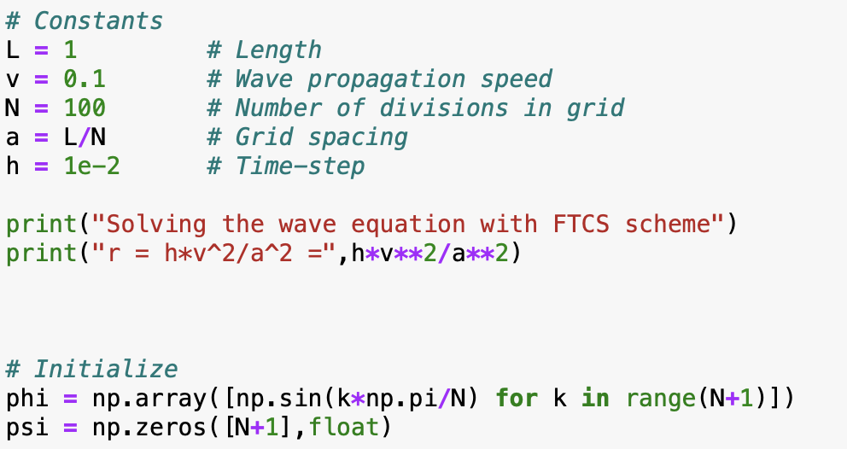
Wave equation
FTCS scheme is unstable
Notes:
The important thing here, however, is that this equation defines how the mean B1 depends on t.
We can thus use this straightforwardly to calculate the higher-order cumulants by taking the derivatives from this equation with respect to t.
And by repeatedly abusing the Faa di Bruno formula for high-order derivatives of composite functions we can calculate the net-baryon cumulants subject to global baryon conservation up to a desired order.
Here I am showing the results for three cumulants ratios, the so-called scaled variance, skewness, and kurtosis, our paper contains explicit results up to order 6.
We obtain the B1 cumulants in terms of the subvolume fraction \alpha and the grand-canonical susceptibilities \chi_B.
This is exactly what we want, as the grand-canonical susceptibilities are the intrinsic properties of the equation of state that we want to probe.
Unsurprisingly, in the limit \alpha goes to zero we obtain the grand-canonical susceptibility ratios.
Let me reiterate again that here I did not assume anything about the equation of state, this result is model-independent.

Slide 23
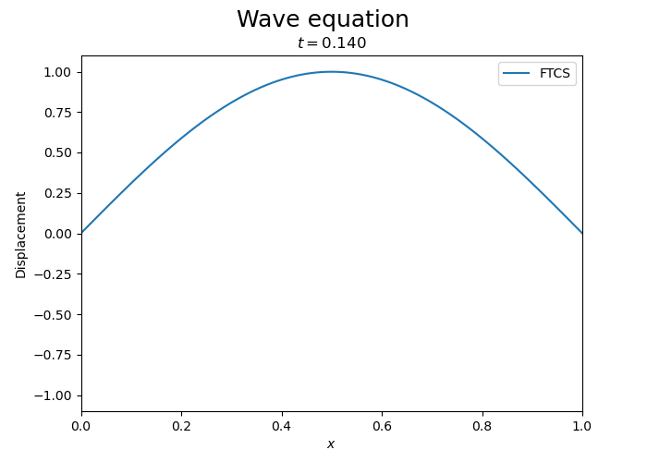
Wave equation
FTCS scheme is unstable
Notes:
The important thing here, however, is that this equation defines how the mean B1 depends on t.
We can thus use this straightforwardly to calculate the higher-order cumulants by taking the derivatives from this equation with respect to t.
And by repeatedly abusing the Faa di Bruno formula for high-order derivatives of composite functions we can calculate the net-baryon cumulants subject to global baryon conservation up to a desired order.
Here I am showing the results for three cumulants ratios, the so-called scaled variance, skewness, and kurtosis, our paper contains explicit results up to order 6.
We obtain the B1 cumulants in terms of the subvolume fraction \alpha and the grand-canonical susceptibilities \chi_B.
This is exactly what we want, as the grand-canonical susceptibilities are the intrinsic properties of the equation of state that we want to probe.
Unsurprisingly, in the limit \alpha goes to zero we obtain the grand-canonical susceptibility ratios.
Let me reiterate again that here I did not assume anything about the equation of state, this result is model-independent.

Slide 24
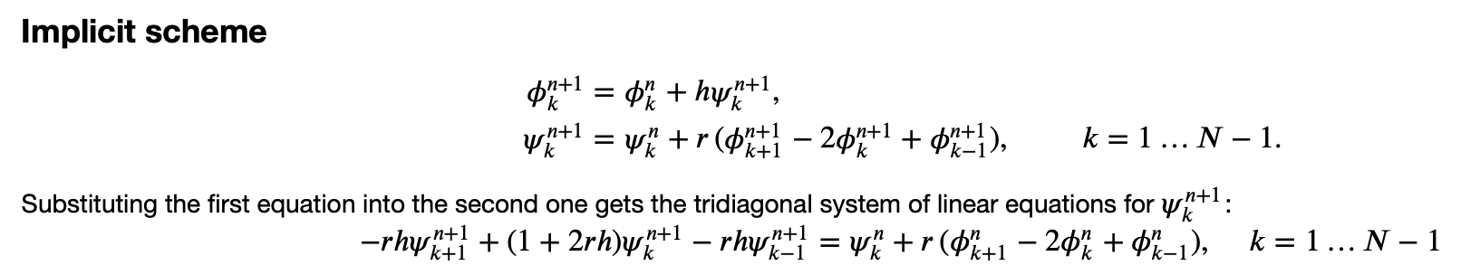
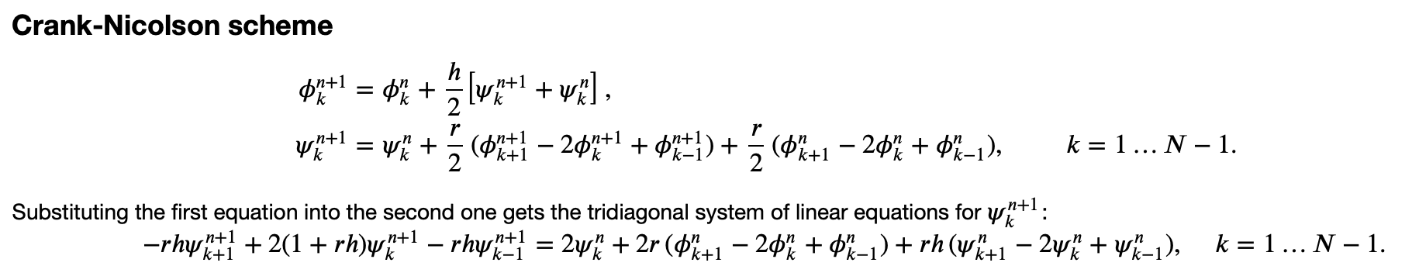
Wave equation: other schemes
Stable, but has exponential decay (waves don’t propagate forever)
Stable, no growth or decay
Notes:
The important thing here, however, is that this equation defines how the mean B1 depends on t.
We can thus use this straightforwardly to calculate the higher-order cumulants by taking the derivatives from this equation with respect to t.
And by repeatedly abusing the Faa di Bruno formula for high-order derivatives of composite functions we can calculate the net-baryon cumulants subject to global baryon conservation up to a desired order.
Here I am showing the results for three cumulants ratios, the so-called scaled variance, skewness, and kurtosis, our paper contains explicit results up to order 6.
We obtain the B1 cumulants in terms of the subvolume fraction \alpha and the grand-canonical susceptibilities \chi_B.
This is exactly what we want, as the grand-canonical susceptibilities are the intrinsic properties of the equation of state that we want to probe.
Unsurprisingly, in the limit \alpha goes to zero we obtain the grand-canonical susceptibility ratios.
Let me reiterate again that here I did not assume anything about the equation of state, this result is model-independent.

Slide 25
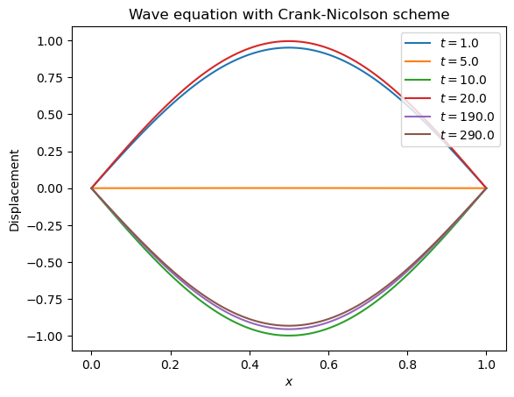
Wave equation with Crank-Nicolson scheme
Notes:
The important thing here, however, is that this equation defines how the mean B1 depends on t.
We can thus use this straightforwardly to calculate the higher-order cumulants by taking the derivatives from this equation with respect to t.
And by repeatedly abusing the Faa di Bruno formula for high-order derivatives of composite functions we can calculate the net-baryon cumulants subject to global baryon conservation up to a desired order.
Here I am showing the results for three cumulants ratios, the so-called scaled variance, skewness, and kurtosis, our paper contains explicit results up to order 6.
We obtain the B1 cumulants in terms of the subvolume fraction \alpha and the grand-canonical susceptibilities \chi_B.
This is exactly what we want, as the grand-canonical susceptibilities are the intrinsic properties of the equation of state that we want to probe.
Unsurprisingly, in the limit \alpha goes to zero we obtain the grand-canonical susceptibility ratios.
Let me reiterate again that here I did not assume anything about the equation of state, this result is model-independent.

Slide 26
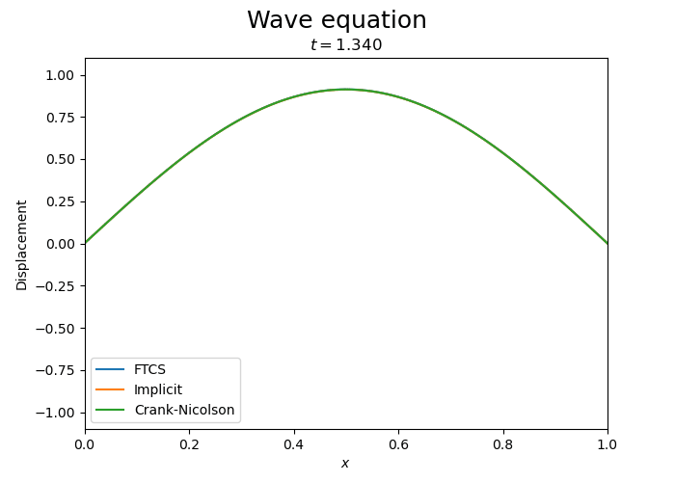
Wave equation: Comparison
Notes:
The important thing here, however, is that this equation defines how the mean B1 depends on t.
We can thus use this straightforwardly to calculate the higher-order cumulants by taking the derivatives from this equation with respect to t.
And by repeatedly abusing the Faa di Bruno formula for high-order derivatives of composite functions we can calculate the net-baryon cumulants subject to global baryon conservation up to a desired order.
Here I am showing the results for three cumulants ratios, the so-called scaled variance, skewness, and kurtosis, our paper contains explicit results up to order 6.
We obtain the B1 cumulants in terms of the subvolume fraction \alpha and the grand-canonical susceptibilities \chi_B.
This is exactly what we want, as the grand-canonical susceptibilities are the intrinsic properties of the equation of state that we want to probe.
Unsurprisingly, in the limit \alpha goes to zero we obtain the grand-canonical susceptibility ratios.
Let me reiterate again that here I did not assume anything about the equation of state, this result is model-independent.

Slide 27
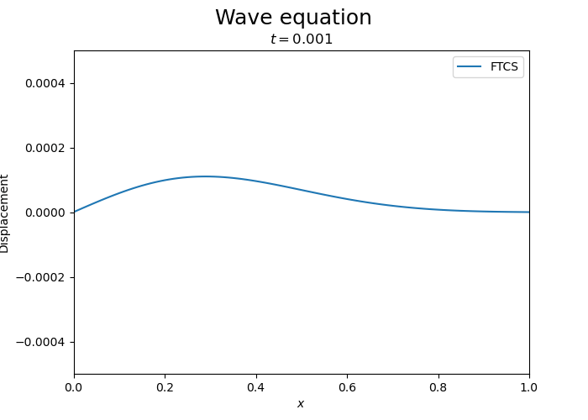
Wave equation: Pulses
Notes:
The important thing here, however, is that this equation defines how the mean B1 depends on t.
We can thus use this straightforwardly to calculate the higher-order cumulants by taking the derivatives from this equation with respect to t.
And by repeatedly abusing the Faa di Bruno formula for high-order derivatives of composite functions we can calculate the net-baryon cumulants subject to global baryon conservation up to a desired order.
Here I am showing the results for three cumulants ratios, the so-called scaled variance, skewness, and kurtosis, our paper contains explicit results up to order 6.
We obtain the B1 cumulants in terms of the subvolume fraction \alpha and the grand-canonical susceptibilities \chi_B.
This is exactly what we want, as the grand-canonical susceptibilities are the intrinsic properties of the equation of state that we want to probe.
Unsurprisingly, in the limit \alpha goes to zero we obtain the grand-canonical susceptibility ratios.
Let me reiterate again that here I did not assume anything about the equation of state, this result is model-independent.

Slide 28
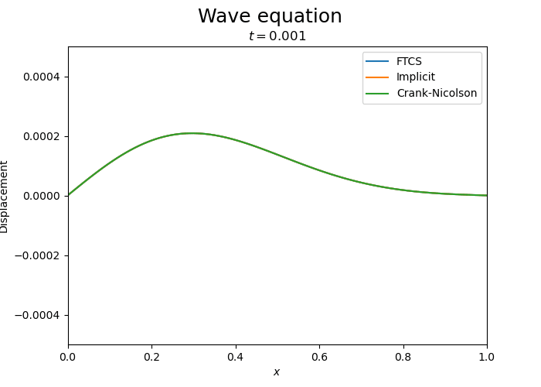
Wave equation: Pulses
Notes:
The important thing here, however, is that this equation defines how the mean B1 depends on t.
We can thus use this straightforwardly to calculate the higher-order cumulants by taking the derivatives from this equation with respect to t.
And by repeatedly abusing the Faa di Bruno formula for high-order derivatives of composite functions we can calculate the net-baryon cumulants subject to global baryon conservation up to a desired order.
Here I am showing the results for three cumulants ratios, the so-called scaled variance, skewness, and kurtosis, our paper contains explicit results up to order 6.
We obtain the B1 cumulants in terms of the subvolume fraction \alpha and the grand-canonical susceptibilities \chi_B.
This is exactly what we want, as the grand-canonical susceptibilities are the intrinsic properties of the equation of state that we want to probe.
Unsurprisingly, in the limit \alpha goes to zero we obtain the grand-canonical susceptibility ratios.
Let me reiterate again that here I did not assume anything about the equation of state, this result is model-independent.

